Slide 1


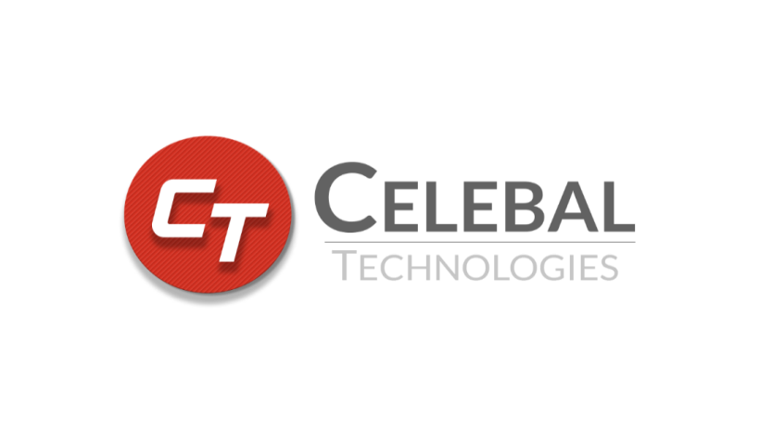
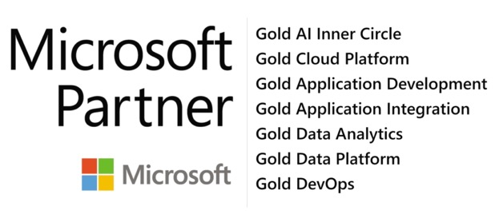
Royal Enfield – EDW Modernization Proposal

Slide 2

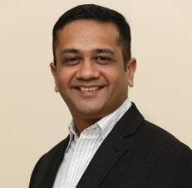


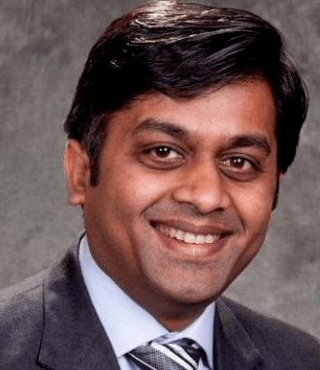
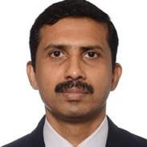


Leadership
Anupam Gupta, Co-founder , Head of US Operations
Anupam brings in 22 years of Development and Global Consulting experience with Enterprise Software Solutions. He has been advising customers on Enterprise strategy and Technology Road maps. He Holds a B.Tech. from IIT Bombay
Anirudh Kala, Co-founder, Director, Chief Data Scientist
Anirudh is an expert in Machine Learning techniques, Artificial Intelligence and Natural Language Processing using Azure and Cortana Services. He has led AI ML COE for various organization throughout the globe.
Dinesh Thawani, Promoter and CTO
Dinesh has 20+ years of tech experience in delivering Cloud based Enterprise Solutions & raising strong teams. He has led multiple practices in various disciplines of Technology, in Bay Area and Greater Atlanta city. He did Grad Studies in Theoretical CS at India’s premier Tata Institute of Fundamental Research, Mumbai and is a Gold Medallist in CS at NIT, Jaipur
Piyush Gupta, Global Head, ERP Modernization Practice
Piyush Gupta brings in 21 years of experience in IT services and Enterprise Product Development. He has a strong track record of leading large global enterprise programs across multiple industry verticals and setting up Global SAP Practices and running Global Operations.
Anish Ashirgade, Head Celebal Tech. Singapore
Anish has 20+ years of experience in SAP Analytics with expertise enterprise in Automation. Currently he leads the SAP practise for Celebal Asia pacific region and is based out of Singapore
Abhishek Goyal, Solutions Sales Principal
Abhishek brings in about 20 years of Sales and Marketing experience across Industry domains. Having a keen Engineering interest and background empowers Abhishek in Technology Solution Sales and Services.
Mukul Biswas, Head Celebal Tech. UK
Mukul has 22+ years of experience in SAP and has led large practises of SAP analytics and Implementation for Global SI around the world. Mukul holds a B.Tech from IIT Delhi
Prankul Middha, Enterprise Solution Specialist
Prankul has over 20 years of experience from the US, Europe and India within Consultancy, Engineering, Software, Business development and Solution sales. He is currently expanding Celebal Tech’s practice in the Nordics and continental Europe. He Holds a B.Tech from IIT Delhi

Slide 3







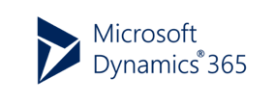







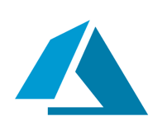

Celebal Technologies – Traditional Enterprise + Modern Cloud
380+
Azure Certifications
650+
Global Presence
US
UK
Singapore
India
Employees
Pioneers in SAP Surround on Azure
Notes:
About us - Who we are

Slide 4












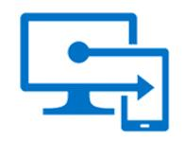

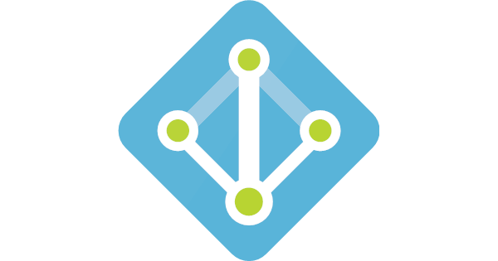

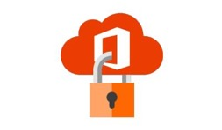

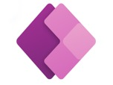




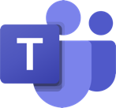
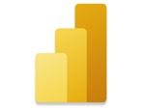

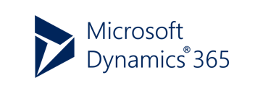


The Complete Cloud – Productivity, Apps, Hosting & Analytics
Data and AI
Apps and Infra
Synapse Analytics
ADF
Azure Kubernetes
Azure VM
Security
Azure Intelligent
Cloud
Azure Intelligent
Cloud
Azure ML
Azure Databricks
Security
Center
Azure
Migrate
Azure Endpoint Security
DMS
Business Applications
Modern Workplace
Azure Active Directory
M365 Security
Azure Information Protection
Power Platform
Modern Workplace

Slide 5

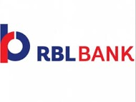




















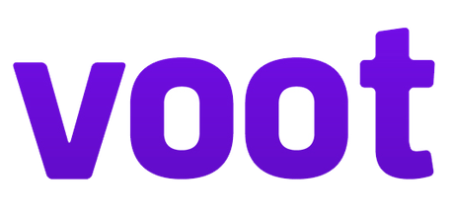








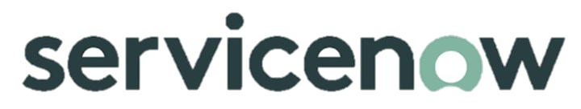






Our Clients
BFSI
Manufacturing
Energy/Utility
Telecom/Media
Pharma
ITES
Government
Realty
Logistics
Education
Advisory

Slide 6

Table of Contents
Current Architecture
Problem Statement
Scope of Work
Solution Architecture
Our Approach
Technical Solution
SSIS Package Assessment
Assumptions
Out of Scope
Key Deliverables
Timelines & Commercials
Azure BoM
Change Request

Slide 7
Current Architecture
Data Source
Sql Server A
Sql Server B
Staging Area(RE_EDW_Staging) : Raw data
(Truncate Load)
Final Layer(RE_EDW): Incremental load After Applying Transformations And Cleaning Steps
Sql Server Analysis Service : Tabular Model
DMS(MSD-CRM & FnO)
SSIS
SSIS
Reporting : Power BI
On-Prem SQL Server

Slide 8
Problem Statement
Problem Statement
On-prem SQL Server is a pain point as the business team gets the refreshed data with a lag because of slow processing
No Real Time Data Analytics
No committed PaaS ETL tool with scheduled processing
Less utilisation of Power BI Premium features
Self Service Analytics is not possible
Maintenance of infrastructure is also a pain point

Slide 9
Scope of Work
Data sources for CE Data is Dynamics 365 and for FnO data it is Azure SQL Database
Reconfiguration of 10 Power BI reports
Eliminate on-prem servers for multiple data processing stages
Reduced refresh time for the modules in scope
Migrate data models through Azure Synapse Analytics Services
Tabular Models which need to be created-
DailyDSR [Sales] (CRM and FnO)
JobCardstatement [Service] (CRM and FnO)
WarrantyClaimssettlement [Service] (CRM and FnO)
CubeGearGMA [Apparels and Spares] (CRM)

Slide 10
Scope of Work – Models
Scope of Work – Models
Cube Name | No. of Tables | Size (in GBs) | Frequency of data load of Cube/Model | Source
DailyDSR | 28 | 5.3 | 4 hrs | on prem SQL + MSD (Cloud)
JobCardstatement | 88 | 43.5 | 4 hrs | on prem SQL + MSD (Cloud)
WarrantyClaimssettlement | 44 | 16.2 | 4 hrs | on prem SQL + MSD (Cloud)
CubeGearGMA | 32 | 5.2 | 4 hrs | on prem SQL + MSD (Cloud)
Total |  | 70.2

Slide 11
Our Approach
The data of different business units for Royal Enfield is currently residing in the MS Dynamics 365 for CE & for FnO it is in Azure SQL Database
The approach has been divided into 2 phases:-
Phase 1: It will include current data (3 years) integration of CE from Dynamics to ADLS Gen2 through Azure Synapse Link (Power Apps) & FnO data from Azure SQL DB to ADLS Gen2 through ADF. The data will be pulled into a dedicated SQL Pool in Azure Synapse for the purpose of Modelling.
Phase 2: Once the Azure Synapse link for FnO is Live, the load for CE & FnO Incremental data will be loaded directly to ADLS Gen 2 through Azure Synapse link.
The Azure Data Lake Storage Gen 2 will have Current (3years) and incremental data load of CE and FnO from MSD & Azure SQL DB respectively.
The data from ADLS Gen 2 will then be moved to Azure Synapse dedicated SQL pool with the help of ADF pipelines. The data will be fetched on relevance basis into the Azure Synapse for data modelling in order to consume further for reporting. The reporting data will then be consumed by the visualization tool Power BI to bring the insights to the end users.
The data stored in Azure Synapse would be for previous 3 years (2019 Onwards) and further the data will be archived accordingly
Logic apps will be used for Email Alert mechanism. In case of any pipeline failure the email notification will be sent to the owner from Data Lake.

Slide 12
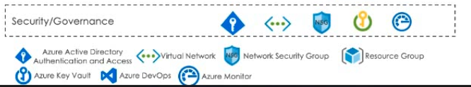

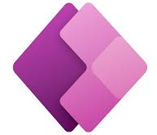
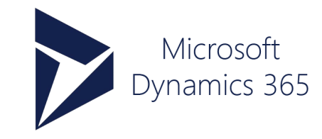
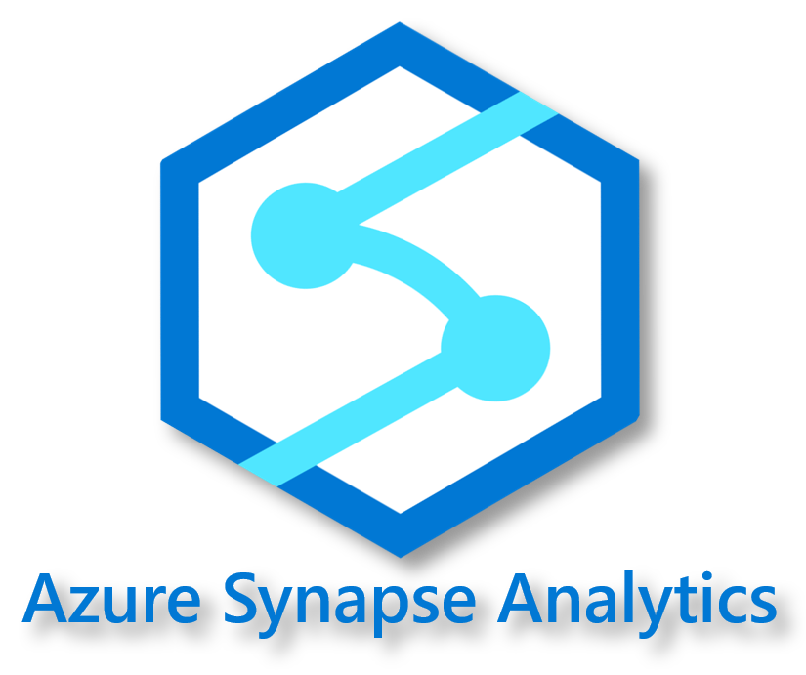
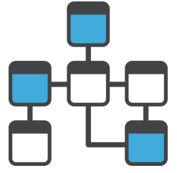



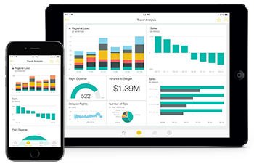


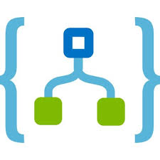



Solution Architecture – Phase 1
Source System
Data Ingestion
Data Analytics
Data Visualization
Azure Synapse Link (Power Apps)
Dataverse
Data Modelling
CE Data (Current-3 years)
Data Modelling
Azure Data Factory
ADLS Gen 2
Power BI Premium
FnO Data (Current-3 years)
Master Tables
Master views
Mail alerts for
Success/Failures
Transactional Tables
Transactional Views
Secrets Management in Azure Key Vault
Azure Synapse Analytics (Dedicated SQL Pools)

Slide 13




Solution Architecture – Phase 1
Source System
Data Ingestion
Data Analytics
Data Visualization
Data Modelling
Data Modelling
Azure Data Factory
ADLS Gen 2
Power BI Premium
CheckIn & Ora Paas
Master Tables
Master views
Mail alerts for
Success/Failures
Transactional Tables
Transactional Views
Secrets Management in Azure Key Vault
Azure Synapse Analytics (Dedicated SQL Pools)
Fusion

Slide 14
Technical Solution-Phase-1
Connectivity of source systems Dynamics and Azure SQL DB will be done, and all data will be pulled into ADLS Gen 2 through Azure Synapse link (CE load) and ADF pipelines (FnO load) .
The data from ADLS gen 2 will be pulled into Azure Synapse dedicated SQL pool by using Azure Data Factory and for further modelling Azure Synapse will be used.
Maintenance of the log count table will be done on Azure Synapse as per all source tables. Also, a Power BI Log dashboard will be provided which will store 3 months log from the count table.
Logic apps will be used for Email Alert mechanism and in case of any pipeline failure the email notification will be sent to the owner.
Transformations would be done on Azure Synapse with the help of Stored Procedures.

Slide 15
Solution Architecture – Phase 2
Source System
Data Ingestion
Data Analytics
Data Visualization
Data Modelling
Azure Synapse Link (Power Apps)
CE & FnO (Incremental Load)
Data Modelling
ADLS Gen2
Power BI Premium
Master Tables
Master views
Mail alerts for
Success/Failures
Transactional Tables
Transactional Views
Secrets Management in Azure Key Vault
Azure Synapse Analytics
(Dedicated SQL Pools)
According to Microsoft team recommendation engine once its Go Live

Slide 16
Technical Solution-Phase-2
Connectivity of source systems Dynamics (FnO) will be done, and Incremental data for CE and FnO will be pulled into ADLS Gen 2 through Azure Synapse link.
The data from ADLS gen 2 will be pulled into Azure Synapse dedicated SQL pool by using Azure Data Factory and for further modelling Azure Synapse will be used.
Maintenance of the log count table will be done on Azure Synapse as per all source tables. Also, a Power BI Log dashboard will be provided which will store 3 months log from the count table.
Logic apps will be used for Email Alert mechanism and in case of any pipeline failure the email notification will be sent to the owner.
Transformations would be done on Azure Synapse with the help of Stored Procedures.

Slide 17
SSIS Package Assessment
The SSIS packages provided were assessed and detailing was performed.
The transformations and cleaning performed on each step was noted on the dataset.
A detailed document has been drafted containing the Job details, steps and the various processes under the steps along with the target table details and time schedules .

Slide 18
Assumptions
1. Prerequisites:
Mapping across data sets to be provided
Client shall make available equal number of Power BI Pro licenses for reconfiguration to the designated Power BI resource
All Data models are clearly defined at user end
Data Dictionary document needs to available for understanding data.
2. Requirement Gathering:
Secured Access to all the Infrastructure through VPN will be given within 1st week of engagement.
Remote access to all databases and process shall be available for Celebal Tech team.
3. Technical & Volumetric:
There are a total of 10 reports that need to be re-configured to Azure Synapse Analytics in this engagement.
If development of new Power BI reports are required by the client side, it would be included under Phase-2 and will be subject to additional charges as per the requisite rate
The ADLS Gen 2 will have current (3 years) and Incremental data load for CE & FnO
The one-time historical load stored in Synapse would be for previous 3 years (2019 Onwards).
This engagement will cover the Data migration and optimization of the tables

Slide 19
Assumptions
4. Data Source Connectivity:
Celebal Tech will be able to connect to all the source systems without additional networking configuration
5. Data Transformations:
Celebal Tech shall not create any data models from scratch and carry out any enhancements in the client’s current Datamart model
Optimization in the current code will be carried out by Celebal
Celebal Team shall copy the data for base tables from Dynamics and then procedure will execute with the help of Azure Data factory for populating the data into facts and dimensions tables.
All data transformations/aggregations will be carried out by Celebal Tech after analyzing the source data models and the visualization layer requirements. In case the client has any specific design requirements for data modelling, this shall be considered as a change request or a new project.
6. Project Testing:
Testing for latest one month of data sets as per all the reports will be done by Celebal Tech
Later, 3 years data validation will be performed.
Reference documents/numbers will be required from the client for first round of testing by Celebal Tech
Testing & sign-off shall be required from the Client team on each created module

Slide 20
Assumptions
7. Project Timelines & Consulting Fees:
Unless additional resources are hired by the client, Celebal Tech shall provide a dedicated number of resources as mentioned here in after.
In case any problem occurs in the client tools then the resolution within agreed upon timeline is client’s prerogative.
Total project time will be as per the Gantt chart shared in Timeline's slide. In case of any delay from the client side for prerequisites related to requirement gathering, data modelling, data access, Azure access, all kind of business query response, feedback response, UAT sign-off, business availability for testing reports and vendor payment, will attract additional charge at requisite rate.
A dedicated Team member shall be the coordinator between the Celebal Tech and the client team, throughout the project life cycle.
Business Team feedback turn-around time is 2 working days for each Report. Any delay beyond 2 days, will have a direct impact on the project timelines.
Maximum 2 iterations of changes shall be taken from the business team. Any more changes will be considered only (if approved) in C.R. Project Timelines will be revised accordingly.
Unless approved in change management, we will follow the time-frames mutually decided for each action prior to the project.
Changes in the KPI while pointing it to Synapse may increase the time frame of the overall project.

Slide 21
Out of Scope
Real time view of data; refresh rate would be set as per feasibility
Improving/interventions to improve performance of existing systems
Anything else that has not been explicitly mentioned in scope
Any enhancement in the client’s current Datamart model
Maintaining & debugging client policy controls and firewall
Any change in the source structure beyond the data sources mentioned in the scope

Slide 22
Key Deliverables
The following deliverables will be provided as part of the project:
SSIS Packages will be replaced by Azure Data Factory
Facts and dimensions tables will be populated with the help of stored procedures.
The complete existing Data Model will be migrated to Azure Synapse for different business modules which will support MPP.
10 Power BI reports will be reconfigured.
A dashboard will be configured for checking the 3 months of Count log for each table
The current ROW level Security will be migrated as is to the new platform.
A technical design document and a complete user guide will be provided as per the development during engagement
Testing for latest one month of data sets according to all the reports will be done. Later, current (3 years) data validation will be performed

Slide 23
Timelines
Activities | W 1 | W 2 | W 3 | W 4 | W 5 | W 6 | W 7 | W 8 | W 9 | W10 | W11 | W12 | W13
Phase-1
Infrastructure Setup
Schema Migration
Creation of Data Ingestion Pipelines (Current(3years)/Incremental Load)
Creation of Data Transformation Pipelines (Current(3years)/Incremental Load)
Creation Of Data Validation Pipeline (Current(3years)/Incremental Load)
Data Load (One Month)
Data Load/Data Pipeline (Current(3years)Load)
Report Reconfiguration (10 Reports)
UAT- Sign Off
Go Live
Warranty Period
Note: Warranty period of 2 weeks will be provided Free of cost by the Celebal team after completion of the project.

Slide 24
Timelines
Activities | W 1 | W 2 | W 3 | W 4 | W 5 | W 6 | W 7 | W 8 | W 9 | W10 | W11 | W12 | W13
Phase-1
Infrastructure Setup
Schema Migration
Creation of Data Ingestion Pipelines (Current(3years)/Incremental Load)
Creation of Data Transformation Pipelines (Current(3years)/Incremental Load)
Creation Of Data Validation Pipeline (Current(3years)/Incremental Load)
Data Load (One Month)
Data Load/Data Pipeline (Current(3years)Load)
Report Reconfiguration (10 Reports)
UAT- Sign Off
Go Live
Warranty Period
Note: Warranty period of 2 weeks will be provided Free of cost by the Celebal team after completion of the project.

Slide 25
Timelines
Activities | W 1 | W 2 | W 3 | W 4 | W 5 | W 6
Phase-2
Creation of Data Ingestion Pipelines (Incremental Load for FnO)
Creation of Data Transformation Pipelines (Incremental Load for FnO)
Creation Of Data Validation Pipeline (Incremental Load for FnO)
Data Validation
UAT- Sign Off
Go Live
Warranty Period
Note: Warranty period of 2 weeks will be provided Free of cost by the Celebal team after completion of the project.

Slide 26
Azure BoM-1
Service type | Region | Description | Estimated monthly cost
Data Factory | Central India | Azure Data Factory V2 Type, Data Pipeline Service Type, Azure Integration Runtime: 200 Activity Run(s), 1,400 Data movement unit(s), 2,000 Pipeline activities, 2,000 Pipeline activities – External, Data Factory Operations: 20 x 50,000 Read/Write operation(s), 20 x 50,000 Monitoring operation(s) | ₹41,462.05
Storage Accounts | Central India | Data Lake Storage Gen2, Standard, GRS Redundancy, Hot Access Tier, Hierarchical Namespace File Structure, 2 TB Capacity - Pay as you go, Write operations: 5 MB x 1,00,000 operations, Read operations: 5 1,00,000 x MB operations, 1,00,000 Iterative read operations, 1,00,000 Iterative write operations, 1,00,000 Other operations. 1,000 GB Data Retrieval, 1,000 GB Data Write, 1,000 GB Meta-data storage | ₹20,646.82
Azure Synapse Analytics | Central India | Tier: Compute Optimised Gen2, Dedicated SQL Pools: DWU 500 x 400 Hours, 1 TB of storage with Geo-redundant disaster recovery | ₹2,49,451.81
Key Vault | Central India | Vault: 1,00,000 operations, 0 advanced operations, 0 renewals, 0 protected keys, 0 advanced protected keys; Managed HSM Pools: 0 Standard B1 HSM Pool(s) x 730 Hours | ₹21.61
Logic Apps | Central India | Workloads: Consumption plan, 1,000 Action Executions per day x 30 days, 1 GB Data Retention, 1,000 Standard Connector Executions per day x 30 days, 0 Enterprise Connector Executions per day x 1 day; Integration Service Environment: Premium tier, 0 Base Units x 730 Hours, 0 Scale Units x 730 Hours; Integration Accounts: 0 Standard Integration Accounts x 730 Hours, 0 Basic Integration Accounts x 730 Hours. | ₹342.07
 |  | Total | ₹3,11,924.36

Slide 27
Assuming 272 Tables
Activity Run in Thousand(350)=This Process will consume arround 2800 activities in a single run and we are executing 4 times in a Day that brings the activity run upto 336K so we have taken a little buffer which is 350K.
Data Integration Unit Hrs(2000) For one time Full Load(2000) For one time Full Load=Assuming 500 Activity will fetch data using Azure integration run time i.e. 500(hr)*4(DIU).
Synapse (400 Hrs)- Assuming Pipeline will run 12 hr in a day and another 12 hrs synapse will be in pausing state(assuming all tables will be on import mode in Power BI premium) i.e. 12*30=360 hrs we have taken some buffer that’s why we put 12 hr.
ADLS (10 TB):- We have to store (Current 5 years + Incremental Data) into the ADLS that’s why we are taking 10 TB.

Slide 28
Azure BoM-2
Service type | Region | Description | Estimated monthly cost
Data Factory | Central India | Azure Data Factory V2 Type, Data Pipeline Service Type, Azure Integration Runtime: 200 Activity Run(s), 1,400 Data movement unit(s), 2,000 Pipeline activities, 2,000 Pipeline activities – External, Data Factory Operations: 20 x 50,000 Read/Write operation(s), 20 x 50,000 Monitoring operation(s) | ₹41,462.05
Storage Accounts | Central India | Data Lake Storage Gen2, Standard, GRS Redundancy, Hot Access Tier, Hierarchical Namespace File Structure, 2 TB Capacity - Pay as you go, Write operations: 5 MB x 1,00,000 operations, Read operations: 5 1,00,000 x MB operations, 1,00,000 Iterative read operations, 1,00,000 Iterative write operations, 1,00,000 Other operations. 1,000 GB Data Retrieval, 1,000 GB Data Write, 1,000 GB Meta-data storage | ₹20,646.82
Azure Synapse Analytics | Central India | Tier: Compute Optimized Gen2, Dedicated SQL Pools: DWU 500, 1 year reserved, 1 TB of storage with Geo-redundant disaster recovery | ₹2,85,925.77
Key Vault | Central India | Vault: 1,00,000 operations, 0 advanced operations, 0 renewals, 0 protected keys, 0 advanced protected keys; Managed HSM Pools: 0 Standard B1 HSM Pool(s) x 730 Hours | ₹21.61
Logic Apps | Central India | Workloads: Consumption plan, 1,000 Action Executions per day x 30 days, 1 GB Data Retention, 1,000 Standard Connector Executions per day x 30 days, 0 Enterprise Connector Executions per day x 1 day; Integration Service Environment: Premium tier, 0 Base Units x 730 Hours, 0 Scale Units x 730 Hours; Integration Accounts: 0 Standard Integration Accounts x 730 Hours, 0 Basic Integration Accounts x 730 Hours. | ₹342.07
 |  | Total | ₹3,48,398.32

Slide 29
Assuming 272 Tables
Activity Run in Thousand(200)=This Process will consume arround 1000 activities in a single run and we are executing 6 times in a Day that brings the activity run upto 180K so we have taken a little buffer which is 200K.
Data Integration Unit Hrs(1400) For one time Full Load(1400) For one time Full Load=Assuming 350 Activity will fetch data using Azure integration run time i.e. 350(hr)*4(DIU).
Synapse (1 year Reserved)- Assuming synapse will never Pause and in this we have one benefit If one day we are not using synapse(Like Sunday) so next day we can use those 500 DWU means the cost will maintain same till 1 year.
ADLS (2 TB):- We have to store (Current 3 years + Incremental Data) into the ADLS that’s why we are taking 2 TB.

Slide 30
Thank You

